Slide 1
Oksana Stepanova
Case Study
Rockbuster – Sales trends and customer behavior analysis
GitHub

Slide 2


Project Overview
Rockbuster Stealth LLC is a movie rental company that used to have stores around the world. Facing stiff competition from streaming services such as Netflix and Amazon Prime, the Rockbuster Stealth management team is planning to use its existing movie licenses to launch an online video rental service in order to stay competitive.
The objective of the project is to perform data analysis to help with launching a strategy for the new online video service using the existing movie licenses.
Use historical data to identify the sales trends, customers’ behavior and to make a spatial analysis of customers’ distribution.

Slide 3
Data – Tools - Skills
Data
Rockbuster dataset
PostgreSQL Database
Skills
Data structure | Extracting ERD, creating a Data Dictionary
Data Analysis | Querying and filtering data
Cleaning & summarizing | Handling duplicates and missing values, checking for inconsistences and non-uniformed data
Joint tables | Inner, left, right, full and multiple joins
Subqueries & CTE | Performing temporary tables as subqueries and CTE
Tools
PostgreSQL
DbVisualizer
Tableau
Excel
Power Point

Slide 4
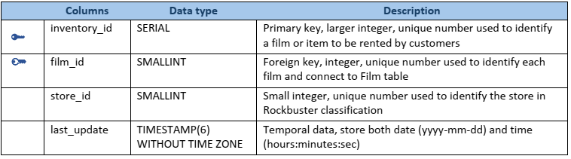
Data Dictionary
Data storage structure
Two Fact tables and thirteen Demotion tables. Identify primary and foreign key for each table. Identify common data types in relational database.
Create a data dictionary as a separate document to present consolidated structure and organization of database and details about each table. Each table is presented the name of the columns, data type and data description. Primary and foreign key columns are clearly marked. The relationship between tables are presented as tables ‘linked to’ or ‘linked from’
Extract Entity relationship diagram (ERD) using DbVizualizer. Include ERD into data dictionary document. Use ERD for analysis and write queries.
Creating a data dictionary
Entity Relationship Diagram
Table Inventory:
Example of a dimension table
from Data Dictionary
4

Slide 5
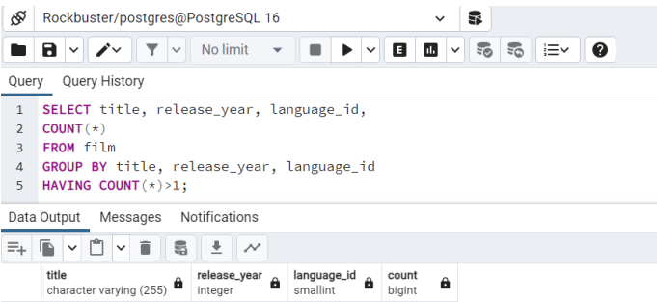
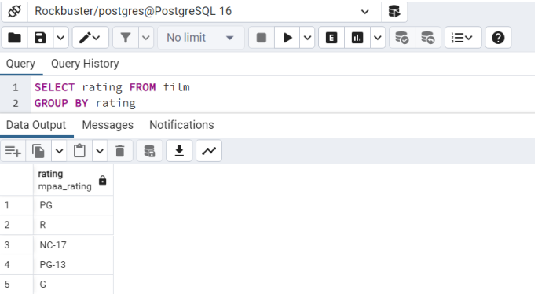
Challenges & Solutions Cleaning data in SQL
Handling Duplicate data
I determined the data grain and checked for duplicates using the variables that could form the lowest level of detail in both tables. For instance, in Film table, the grain data is the combination of three variables: title, release_year, language_id.
As the result, no duplicate data is identified.
If any duplicates were found, I would create a view table and select only unique rows and by using GROUP BY function. Another option is using DELETE function and filtering using WHERE … NOT IN.
Handling Non-uniform data
I checked for inconsistencies using GROUP BY.
I have not identified any non-uniform data.
If any, we can fix it by updating the table and replacing non-regular values.

Slide 6
Challenges & Solutions Common Table Expressions (CTE) vs Subquiries
I compared using Subqueries and Common Table Expressions (CTE) aiming at optimizing SQL queries.
I wrote SQL statements to answer two business questions: what is the average amount paid by top-5 customers? (ii) What are the top-10 countries by customers count? The SQL queries are available in my depository SQL queries
Subquiries
Common Table Expressions
Created three inner tables (top-10 countries, top 10-cities, top-5 customers);
Used the same functions or operators (WHERE, GROUP BY, ORDER BY) at each stage;
The queries can be simplified by using WHERE city / country IN + list pre-selected cities or countries. However, this option is not advisable if we are using constantly changing data.
Costs:
Average payment – subquery method – 65 msec;
Top-customers list – subquery method – 154 msec.
Created an inner CTE table, to calculate the amount paid by the top-5 customers;
Used a WITH clause, gave the title to CTE-table for reference in the following clause;
Added the clauses to calculate the average payment;
Creating CTE to select top-5 customers by using WITH clause;
Used LEFT JOIN to show the 5 customers by the total payment in the top-10 counties.
Costs:
Average payment – CTE – 43 msec;
Top-customers list – CTE – 95 msec.
vs
Using CTE query we can save about 30% of time for running the queries.

Slide 7
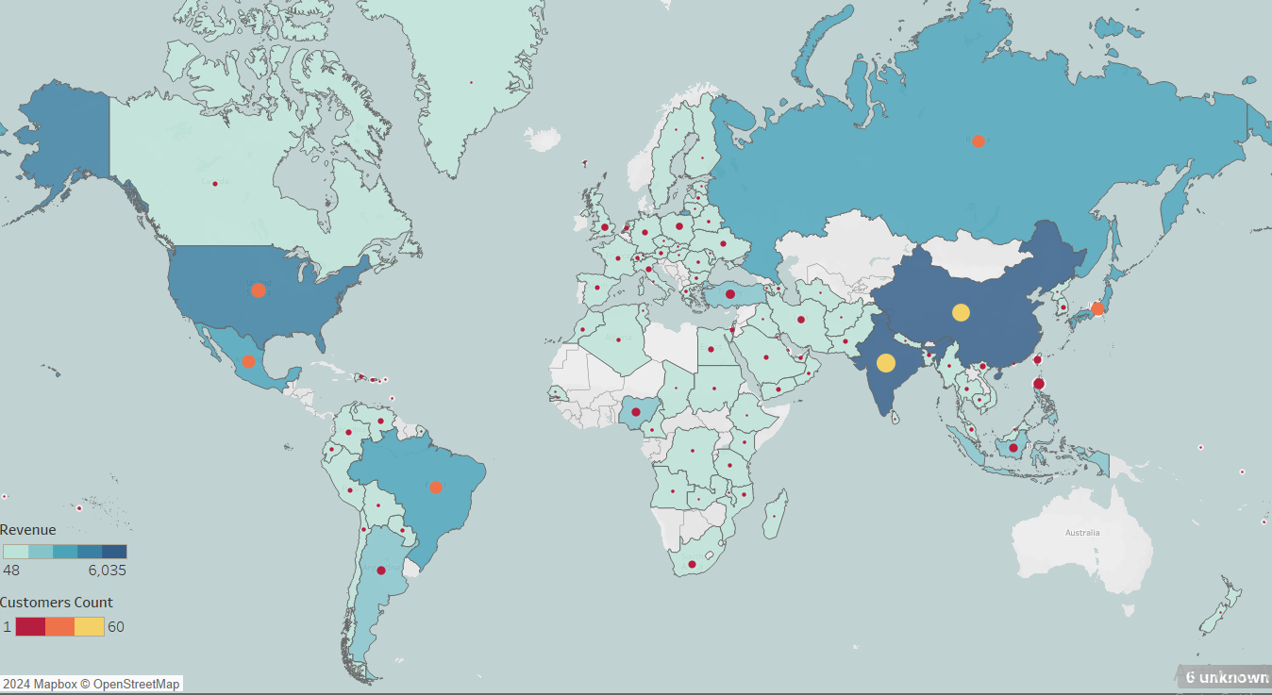
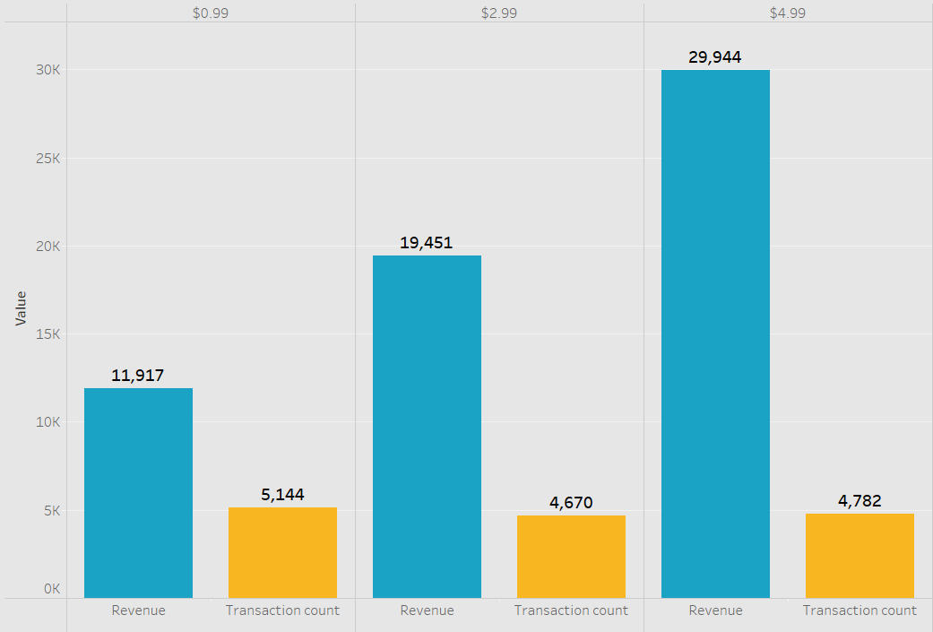
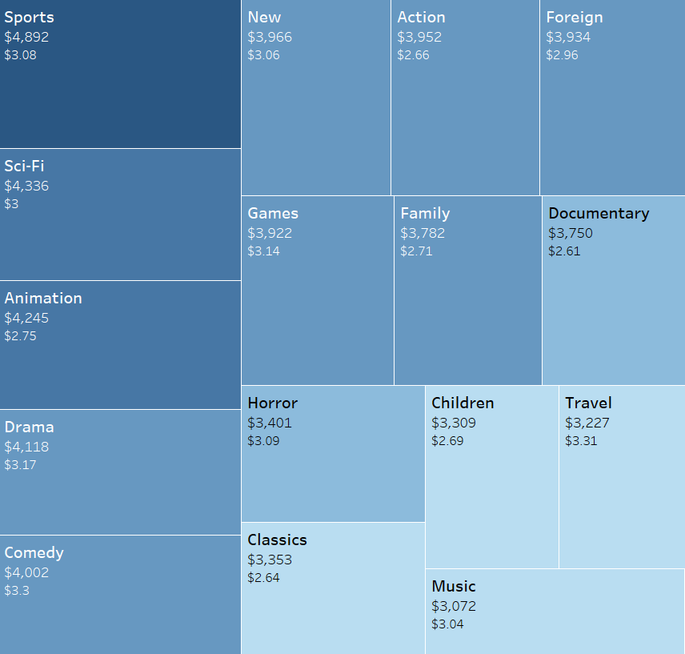
Data Visualization
What are their movie preferences?
The movies at the lowest rate of $0.99 are rented most frequently. These transactions account for 35% of sales, however, generated 20% of revenue.
49% of revenue is generated from sales of the movies rented at the highest rental rate $4.99.
The most popular genres across all countries are Sports, Sci-Fi, Animation, Drama and Comedy.
Who are our customers?
Our customers reside in 108 countries across the world.
The Top-5 countries are India, China, Japan, USA, Mexico.
More than 50 % of customers are based in the Top-10 countries.
The Top-10 countries have generated 52% of revenue.
89% of customers from the top-10 countries are based in non-English speaking countries.
7

Slide 8
Recommendations & My learning insights
Start streaming online by piloting in the top-5 countries.
Develop a system for ranking films by genre and film rating. Make decisions about purchasing new licenses based on the rating system, target audiences and their movie preferences.
Review the maturity of license on a regular basis and discontinue those which have not been rented in the last 12 months (43 items on the current list) or the movies that have been purchased less than 10 times in the last 12 months (166 films)
Invent a pricing strategy based on the films’ popularity and move the movies to a lower rental rate category once the number of sales shows a decreasing trend.
Common Table Expressions (CTE) can be used for the same purposes as subqueries. However, CTE has a more readable structure, and can be referenced multiple times from a calling query. It also allows saving time for running queries.
When data is stored in multiple tables, we may need to create several joint tables, and this makes our statements long and hard readable. We can simplify the queries if we use WHERE / IN. However, this option is not advisable if we are using constantly changing data.
Comparing Excel and SQL for data analysis, the latter is a better option for a relational database with multiple tables.

Slide 9


Thank you!
Oksana Stepanova
Links to more deliverables
Tableau visualization GitHub Repo

